Slide 1

Department of Cyber Security
2026-2027- Odd Semester
III Year /V Sem
CS23533-FOUNDATIONS OF ARTIFICIAL INTELLIGENCE
Zeroth Review – 31/07/2026

Slide 2
INTELLIGENT UNIVERSITY TIMETABLE GENERATOR
Batch Members :
1. Name: Reg.no : Ponsurabhi.V 241901077
2. Name: Reg.no : Swarnamala.V 241901116
Supervisor:
Dr. S.Bhuvana
^{Assistant Professor[SG]}

Slide 3
OUTLINE
Abstract
Objective
Literature Survey
Summary of Literature
Proposed System & Novelty
Block Diagram
Hardware/Software requirements
References

Slide 4
ABSTRACT
University timetable scheduling is a complex problem involving multiple constraints such as faculty availability, classroom allocation, subject hours, and section scheduling. Manual timetable preparation is time-consuming and often results in scheduling conflicts. This project proposes an Intelligent Adaptive University Timetable Generator based on Constraint Satisfaction Problem (CSP) and Backtracking Search. The system automatically generates a conflict-free timetable while satisfying all predefined constraints. Unlike conventional timetable generators, the proposed system supports adaptive timetable regeneration by rescheduling only the affected classes when a faculty member becomes unavailable, thereby preserving the remaining timetable.

Slide 5
OBJECTIVE
Automate university timetable generation.
Eliminate faculty, room, and section conflicts.
Apply Classical AI using CSP and Backtracking Search.
Generate a valid timetable satisfying all hard constraints.
Support adaptive rescheduling for faculty unavailability.
Reduce manual scheduling effort and improve efficiency.

Slide 6
Literature Survey
TITLE | YEAR | AUTHOR | TECHNIQUE
Constructing University Timetable Using Constraint Satisfaction Programming Approach | 2005 | Lixi Zhang, Sim Kim Lau | CSP, Backtracking
A Visual Entity-Relationship Model for Constraint-Based University Timetabling | 2011 | Islam Abdelraouf, Slim Abdennadher & Carmen Gervet | Constraint Programming, Entity–Relationship Modeling, CSP
Educational Timetabling: Problems, Benchmarks and State-of-the-Art Results | 2022 | Matteo Ceschia, Tommaso Di Gaspero, Andrea Schaerf et al. | Constraint Programming, Metaheuristics, Benchmark Analysis
Investigations of a Constraint Logic Programming Approach to University Timetabling | 2005 | Czarina Cheng, Le Kang, Norrus Leung et al. | Constraint Logic Programming (CLP), Logic-Based Scheduling
Decomposition, Reformulation, and Diving in University Course Timetabling | 2009 | Edmund K. Burke, Jakub Mareček, Andrew J. Parkes et al. | Integer Programming, Decomposition, Heuristic Optimization

Slide 7
EXISTING SYSTEM
Manual timetable preparation is time-consuming.
Difficult to satisfy multiple constraints simultaneously.
Faculty and room conflicts may occur.
Entire timetable is regenerated even for minor changes.
High administrative effort.
Limited flexibility in handling schedule modifications.

Slide 8
PROPOSED SYSTEM
Models timetable generation as a Constraint Satisfaction Problem.
Uses Backtracking Search to generate conflict-free schedules.
Ensures faculty, room, and section constraints are satisfied.
Automatically allocates subjects based on weekly hours.
Provides efficient timetable generation.
Supports adaptive rescheduling for faculty absence.

Slide 9
Novelty in Proposed System
Traditional systems regenerate the complete timetable whenever changes occur.
Our proposed system:
Identifies only the affected classes.
Removes only those timetable entries.
Reapplies CSP only to affected classes.
Preserves all unaffected timetable entries.
Reduces unnecessary recomputation.
Improves timetable stability.

Slide 10
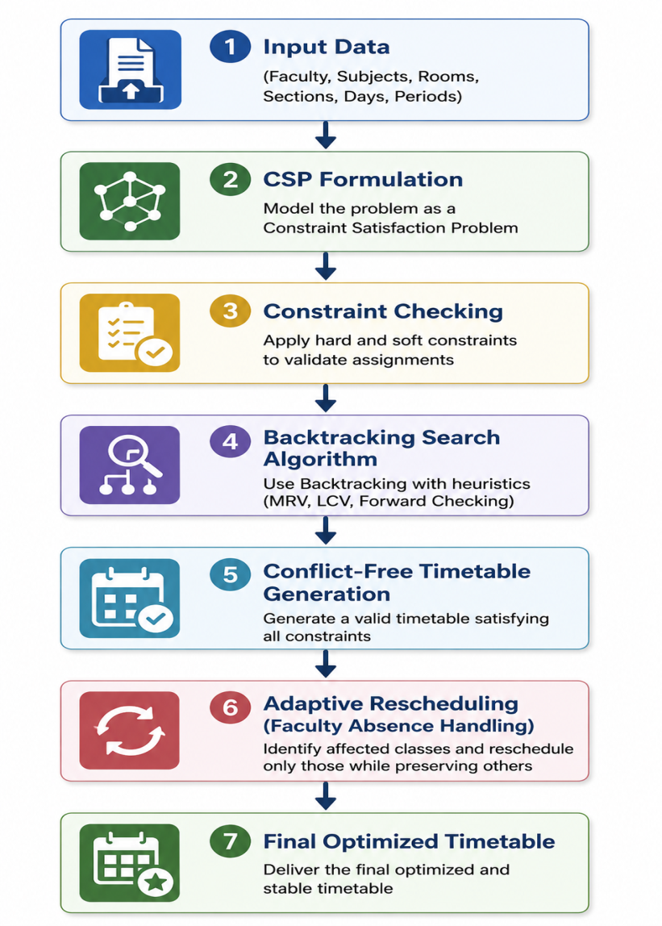
BLOCK DIAGRAM(PROPOSED SYSTEM)

Slide 11
Hardware/Software Requirements
Software Requirements:
Hardware Requirements:
Intel i3/i5 Processor or above
8 GB RAM
20 GB Free Storage
Operating System | Windows 10/11, Linux, or macOS
Programming Language | Python 3.12 or above
IDE/Code Editor | Visual Studio Code
Framework | Flask
AI Technique | Constraint Satisfaction Problem (CSP), Backtracking Search, MRV, LCV, Forward Checking
Database | SQLite (or MySQL for future enhancement)
Version Control | Git & GitHub
Python Libraries | Flask, Pandas, NumPy, Matplotlib, Tabulate
Package Manager | pip
Web Browser | Google Chrome / Microsoft Edge

Slide 12
References
Journals
[1] Zhang, L., & Lau, S. K. (2005). Constructing university timetable using constraint satisfaction programming approach. Proceedings of the International Conference on Computational Intelligence for Modelling, Control and Automation, 2, 55–60. https://doi.org/10.1109/CIMCA.2005.1631445
[2] Abdelraouf, I., Abdennadher, S., & Gervet, C. (2011). A visual entity-relationship model for constraint-based university timetabling. arXiv. https://arxiv.org/abs/1109.6112
[3] Ceschia, M., Di Gaspero, T., Schaerf, A., & others. (2022). Educational timetabling: Problems, benchmarks and state-of-the-art results. Annals of Operations Research.
[4] Cheng, C., Kang, L., Leung, N., & White, G. M. (2005). Investigations of a constraint logic programming approach to university timetabling. Lecture Notes in Computer Science.
[5] Burke, E. K., Mareček, J., Parkes, A. J., & Rudová, H. (2009). Decomposition, reformulation, and diving in university course timetabling. Operations Research Proceedings. https://arxiv.org/abs/0903.1095

